Slide 1
CMPE 220
Week 11
Servers (and client/server applications)
Notes:
Let’s talk about history.
California State Railroad Museum – 1976 - docents worked on original steam engines.

Slide 2
The Client / Server Model
A server is a program that runs on a computer, providing a specific service to other program(s), called clients
In the POSIX world, a server is often called a daemon (demon)
a long-running background process that answers requests for services
The server program may launch multiple processes, as needed
The software that makes up a server may - or may not - have system dependencies
Examples:
Database Management System
FTP Server
Mail Server
Web Server
Windowing System

Slide 3
Local or Remote
The client and the server can run on the same machine, or they may run on separate machines and communicate over a network.
Network communication may be hidden by a function call library.
Local Computer
Remote Computer
Application Program
Database Management Server
Database function call
Network
Communication

Slide 4
Accessing Network Services
Client / Server applications require a protocol – a language and a set of rules to allow the client to communicate with the server
Languages do not need to be human readable (i.e. could be binary)
Early protocols were ad hoc – made up by the application developer
FTP: File Transfer Protocol
Developed in the early 1970s by Abhay Bhushan, a student at MIT
Protocols Encapsulate:
Authentication
Requests
Responses
State & Session Management

Slide 5
Standardizing Protocols: OSI
Open Systems Interconnection model (OSI model): a conceptual model that characterizes and standardizes the communication functions
Adopted as an ISO standard in 1980
Seven Layers
Application Layer
Presentation Layer
Session Layer
Transport Layer
Network Layer
Data Link Layer
Physical Layer

Slide 6
TCP/IP
Transmission Control Protocol / Internet Protocol
Based on research done by the Army Research Projects Agency (ARPA) in the 1960s and 1970s
Standardized by the US Department of Defense in 1982
Administered by the Internet Engineering Task Force (IETF) since 1989
Four Layers:
Application Layer
Transport Layer
Internet Layer
Network Interface Layer

Slide 7
OSI Versus TCP/IP Models
OSI Reference Model
TCP/IP Model
OSI model provides a clear distinction between application, presentation, and session services.
TCP/IP groups these as a single Application layer
In the OSI model, the data link layer and physical are separate layers.
TCP/IP groups these as a single Network layer
Application
Application
Presentation
Session
Transport
Transport
Network
Internet
Data Link
Network
Physical

Slide 8
Application-Specific Protocols
Each type of server (web, database, ftp, etc) has its own protocol specific to that application.
A web server uses the HyperText Transfer Protocol to request web pages
Service-specific protocols are the top layer of the TCP/IP network model
Application Layer
Transport Layer
Internet Layer
Network Interface Layer
Transmission Control Protocol (TCP)
Internet Protocol (IP)

Slide 9
TCP/IP Enabled the Internet
Ubiquitous: supported by virtually every operating system
Essentially makes every system today a Network Operating System
Every device on the Internet has a unique 32-bit IP address, consisting of four 8-bit numbers (4.2 billion addresses):
67.169.41.253
IPv6: an extended protocol which supports 128-bit addresses, made up of eight 16-bit numbers, expressed in hexadecimal
FE80:CD00:0000:0CDE:1257:0000:211E:729C
Drafted by the Internet Engineering Task Force (IETF) in 1998
Finalized in 2017 – currently being deployed worldwide

Slide 10
TCP/IP Service Requests
In addition to IP addresses, the TCP/IP protocol uses the notion of a standard “port” to map requests to specific services
For the Transmission Control Protocol and the User Datagram Protocol, a port number is a 16-bit integer in the header of a message
Reserved (“well-known”) port numbers – by convention:
FTP: port 20/21
Telnet: port 23
DNS: port 53
HTTP: port 80
Servers use system calls to open read operations on network ports to receive incoming client requests
HTTPS: port 443
POP3 (email): port 110
MySQL: port 3306

Slide 11
What Does a (modern) Operating System Do?
Process Management
Interprocess Communications
Input / Output (I/O) Management
Memory Management
File System Management
System Functions and Kernel Mode
User Interaction – (maybe)
Network Services

Slide 12
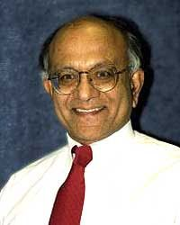
File Transfer Protocol (FTP) - Abhay Bhushan
One of the earliest client/server applications (early 1970s by Abhay Bhushan)
A graduate of the first class (1960–65) from the Indian Institute of Technology Kanpur
Masters in EE from MIT
Drafted RFC 114 – FTP
Contributed to the development of the ARPAnet and email protocols

Slide 13
File Transfer Protocol (FTP)
Originally operated over dialup phone lines
An FTP client connects to an FTP server
Via the client, a user can:
Authenticate (login)
List files
Request (get) files or upload (put) files
Change directories
Rename files
Delete files
FTP Clients
FileZilla
Cyberduck
Transmit
WinSCP
many others

Slide 14
FTP
The FTP client program is started by the user only when needed
The FTP server program is started by the system and continues to run
Local Computer
Remote Computer
FTP Client
User Interface
FTP Server
Local File System
Network
Communication
Remote File System

Slide 15
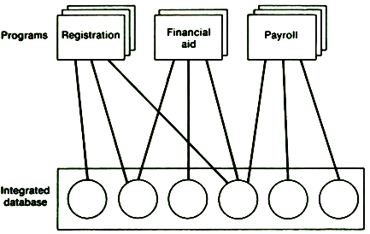
Database Management Systems
A Database Management System (DBMS) allows information to be organized in a structured way, and used by one or more application programs.

Slide 16
A Single Computer DBMS
The DBMS is simply a library
Application Program
Database Management System
File System
I/O System
Hardware
Library

Slide 17
A Networked DBMS
The DBMS consists of a library, and a server
The application and the database server may actually run on the same computer, but still use a network protocol to communicate (localhost)
Network
Communication
Application Program
Database Management Library
Database Management Server
File System
I/O System
Hardware

Slide 18
Database Clients
Any application can be a client of a DBMS server
Database systems usually include a front-end interface that allows programmers to examine and update database contents
This “front end” is simply another client

Slide 19
Is a DBMS System Software?
NO:
Sits on top of the file system
Uses standard communication capabilities
YES:
The DBMS is optimized by taking advantage of specific knowledge of the I/O system and the hardware architecture
Database vendors work closely with system vendors

Slide 20
How Oracle Builds Software
Engineering
Organization
Base
Coding
Porting
Database
Tools
Applications
Sun
IBM/360
Windows
• • •
Over 300 “porting” teams

Slide 21
According to Larry Ellison, founder of Oracle
“Oracle is not a database company. We are a portable software solutions company.”
Just as we saw with high level programming languages, database management systems allow portable applications, by providing a standard interface – a database language – which is tuned to run on a wide range of systems.

Slide 22
Relational Databases
The most widely used “type” of database
Oracle
mySQL
Accessed using Structured Query Language (SQL)
Rigidly defines the data structure
NoSQL or non-relational databases
Allow storage, indexing, and retrieval of unstructured or loosely structured data
A number of types for different purposes

Slide 23

Relational Databases - History
The term "relational database" was invented by Dr. Edgar (Ted) Codd at IBM in 1970.
Codd introduced the term in his research paper "A Relational Model of Data for Large Shared Data Banks". In this paper and later papers, he defined what he meant by "relational".

Slide 24
Relational DB: Entities and Attributes
Entity
Typically represents a real-world concept.
Examples: customer, product, store, event, etc.
Data that the database stores.
Attribute
Characteristic of an entity that the database stores.
Examples (for a customer): name, address, id, etc.
A unique attribute of an entity has a value that is different for each entity instance (such as a customer number)

Slide 25
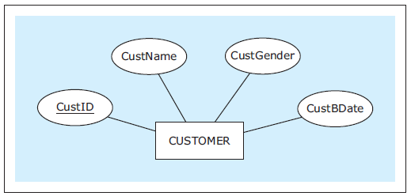
Diagramming Entities and Attributes
An entity relationship diagram, or ER diagram, shows an entity with a rectangle and its attributes with ovals.
Underline the unique attribute.
Database Systems
by Jukić, Vrbsky, & Nestorov
Pearson 2014
ISBN 978-0-13-257567-6

Slide 26
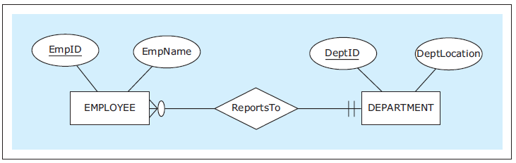
Relationships
Each entity in an ER diagram must be related to at least one other entity.
Show a relationship with a diamond and connect the diamond to the entities that are part of the relationship.
Database Systems
by Jukić, Vrbsky, & Nestorov
Pearson 2014
ISBN 978-0-13-257567-6

Slide 27
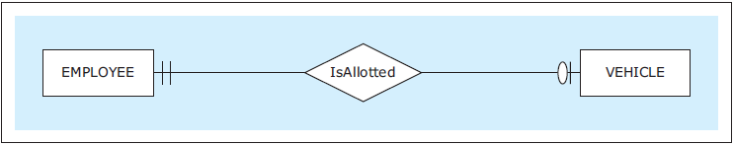
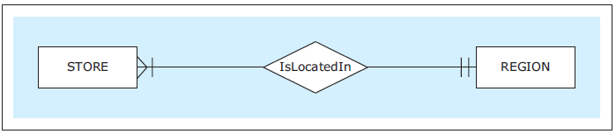
Types of Relationships
One-to-one (1:1)
One-to-many (1:M)
Each employee is allotted at most one (zero or one) vehicle.
Each vehicle is allotted to exactly one employee.
Each region has located in it at least one (i.e., many) stores.
Database Systems
by Jukić, Vrbsky, & Nestorov
Pearson 2014
ISBN 978-0-13-257567-6

Slide 28
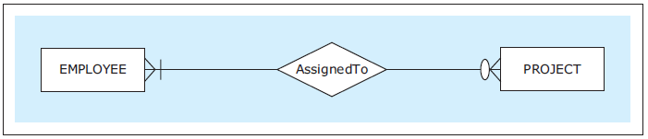
Types of Relationships - continued
Many-to-many (M:N)
Each employee is assigned to zero or several (i.e., many) projects.
Each project has assigned to it at least one (i.e., one or many) employee.
Database Systems
by Jukić, Vrbsky, & Nestorov
Pearson 2014
ISBN 978-0-13-257567-6

Slide 29
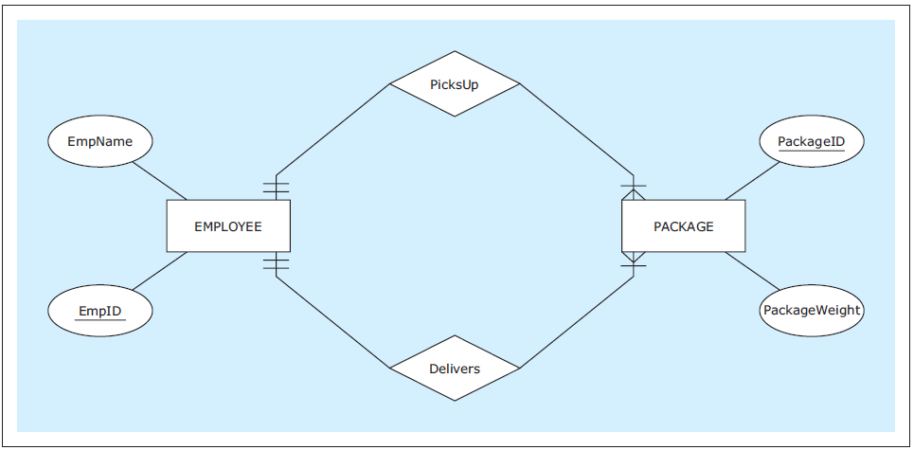
Multiple Relationships
Two entities can have multiple relationships with each other.
Database Systems
by Jukić, Vrbsky, & Nestorov
Pearson 2014
ISBN 978-0-13-257567-6

Slide 30
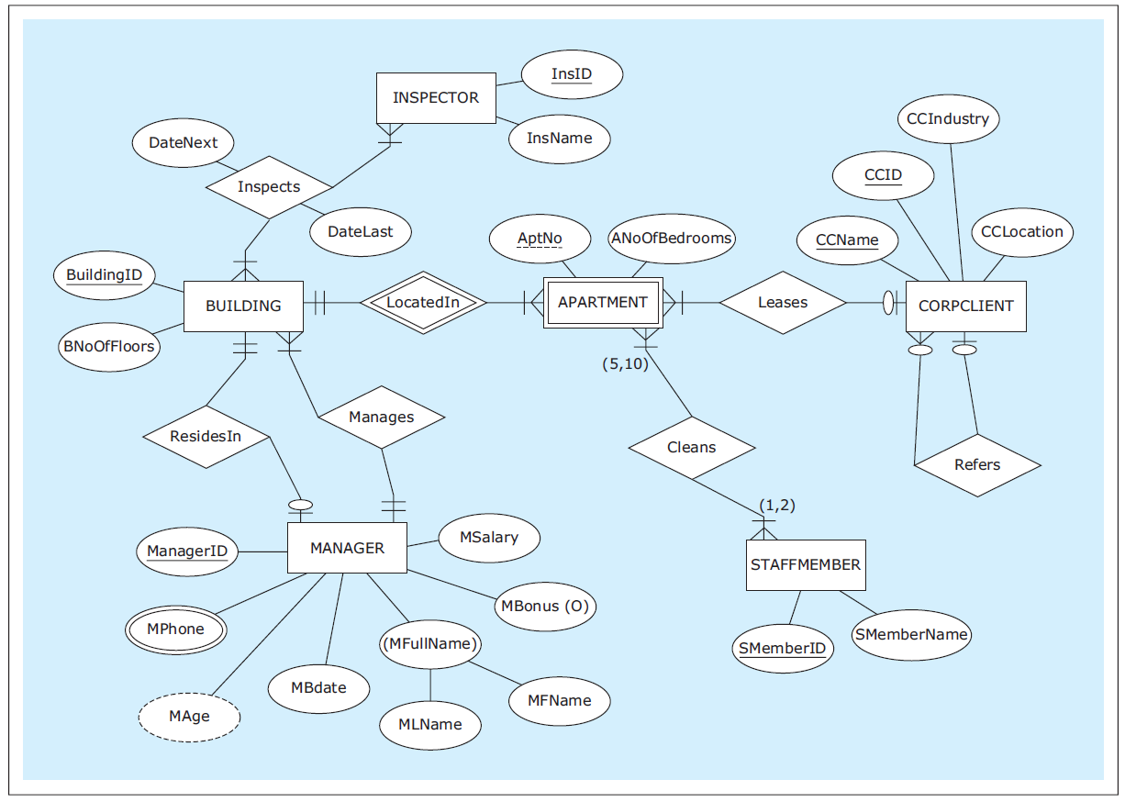
ER Diagram Example
Database Systems
by Jukić, Vrbsky, & Nestorov
Pearson 2014
ISBN 978-0-13-257567-6

Slide 31
Database Design
The ER diagram is the design of our database.
Map the diagram to a set of database tables.
Each table contains related data.
Example: An employee table.
A table is also called a relation.
Each row of a table contains the data of a single record.
Example: One row per employee record.
The table columns are the attributes.
Examples: Employee ID, name, gender, phone number, birthdate, etc.

Slide 32
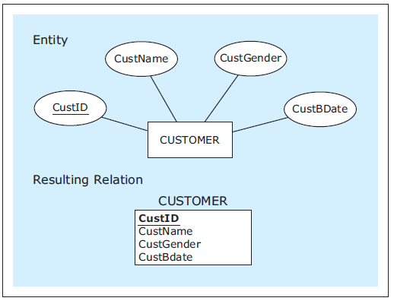
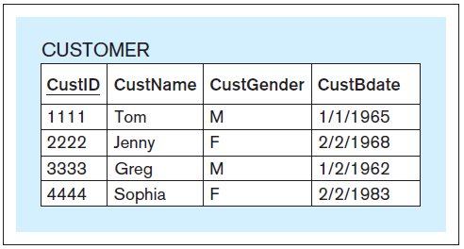
Mapping Entities
ER diagram of the
CUSTOMER entity.
The CUSTOMER table design
An example of a filled
CUSTOMER table.
Database Systems
by Jukić, Vrbsky, & Nestorov
Pearson 2014
ISBN 978-0-13-257567-6

Slide 33
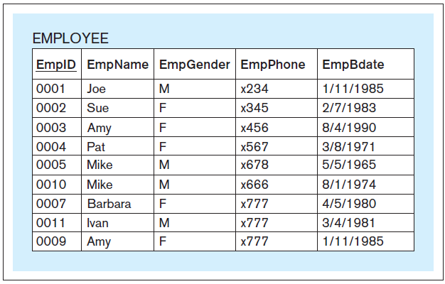
Primary Key
Each table must have a primary key.
A column or set of columns whose value uniquely identifies each row.
Underline the primary key in each database table.
Database Systems
by Jukić, Vrbsky, & Nestorov
Pearson 2014
ISBN 978-0-13-257567-6

Slide 34
Structured Query Language (SQL) Statements
SQL (“Sequel”) is a language for accessing and manipulating relational databases
Statements can be entered on the command line of a database front-end (client)
Statements can be sent by application programs to the database server

Slide 35
SQL – History
SQL was initially developed at IBM by Donald D. Chamberlin and Raymond F. Boyce after learning about the relational model from Edgar F. Codd in the early 1970s.
In June 1979, Relational Software (now Oracle) introduced the first commercially available implementation of SQL for VAX computers.
Approved as an ISO standard in 1987.

Slide 36
SQL Query Examples – single table
What is the class code of the Java programming class?
Class
Code | Teacher_id | Subject | Room
908 | 7008 | Data structures | 114
926 | 7003 | Java programming | 101
931 | 7051 | Compilers | 222
951 | 7012 | Software engineering | 210
974 | 7012 | Operating systems | 109
Desired fields
SELECT code
FROM class
WHERE subject = 'Java programming'
+------+
| code |
+------+
| 926 |
+------+
Source tables
Selection criteria

Slide 37
SQL Query Examples – multiple tables (joins)
Who is teaching Java programming?
Teacher
Class
Id | Last | First
7003 | Rogers | Tom
7008 | Thompson | Art
7012 | Lane | John
7051 | Flynn | Mabel
Code | Teacher_id | Subject | Room
908 | 7008 | Data structures | 114
926 | 7003 | Java programming | 101
931 | 7051 | Compilers | 222
951 | 7012 | Software engineering | 210
974 | 7012 | Operating systems | 109
SELECT first, last
FROM teacher, class
WHERE id = teacher_id
AND subject = 'Java programming'
+-------+--------+
| first | last |
+-------+--------+
| Tom | Rogers |
+-------+--------+
Selecting from multiple tables
is called a join.

Slide 38
SQL Query Examples - multiple tables
What subjects does John Lane teach?
Teacher
Class
Id | Last | First
7003 | Rogers | Tom
7008 | Thompson | Art
7012 | Lane | John
7051 | Flynn | Mabel
Code | Teacher_id | Subject | Room
908 | 7008 | Data structures | 114
926 | 7003 | Java programming | 101
931 | 7051 | Compilers | 222
951 | 7012 | Software engineering | 210
974 | 7012 | Operating systems | 109
SELECT code, subject
FROM teacher, class
WHERE last = 'Lane' AND first = 'John'
AND id = teacher_id
+------+----------------------+
| code | subject |
+------+----------------------+
| 951 | Software engineering |
| 974 | Operating systems |
+------+----------------------+

Slide 39
SQL Query Examples - multiple tables
Who is taking Java programming?
Takes
Student_id | Class_code
1001 | 926
1001 | 951
1001 | 908
1005 | 974
1005 | 908
1014 | 931
1021 | 926
1021 | 974
1021 | 931
SELECT id, last, first
FROM student, class, takes
WHERE subject = 'Java programming'
AND code = class_code AND id = student_id
+------+-------+-------+
| id | last | first |
+------+-------+-------+
| 1001 | Doe | John |
| 1021 | Smith | Kim |
+------+-------+-------+
Class
Student
Code | Teacher_id | Subject | Room
908 | 7008 | Data structures | 114
926 | 7003 | Java programming | 101
931 | 7051 | Compilers | 222
951 | 7012 | Software engineering | 210
974 | 7012 | Operating systems | 109
Id | Last | First
1001 | Doe | John
1005 | Novak | Tim
1009 | Klein | Leslie
1014 | Jane | Mary
1021 | Smith | Kim

Slide 40
SQL Update Statement - example
Fixing a typo (last row of table)
Class
Code | Teacher_id | Subject | Room
908 | 7008 | Data structures | 114
926 | 7003 | Java programming | 101
931 | 7051 | Compilers | 222
951 | 7012 | Software engineering | 210
974 | 7012 | Operating sytsems | 109
UPDATE class
SET subject = ‘Operating systems’
WHERE code = ‘974’

Slide 41
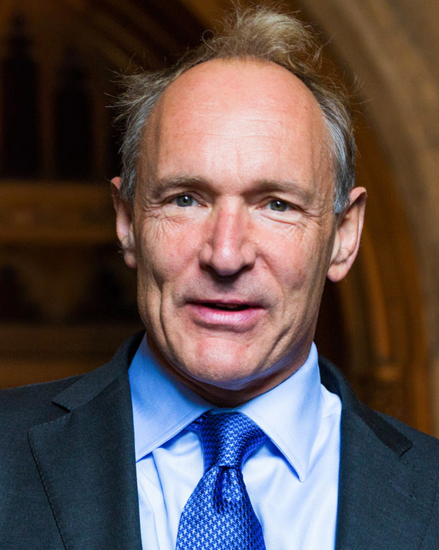
Web Servers
The first web browser and server were created by Sir Tim Berners-Lee in 1990
Berners-Lee was knighted by Queen Elizabeth II in 2004
Browser: a web client
Google Chrome
Firefox
Safari
Internet Explorer
Edge
Web Servers
Apache
Microsoft Internet Information Service (IIS)

Slide 42
Basic Web Protocols
Web Browsers use two basic services
Domain Name Server (DNS Server)
Looks up a domain name to get an IP address
User Datagram Protocol (UDP) – a low latency protocol - on port 53
Web Server
Responds to web page requests
HyperText Transfer Protocol (HTTP) – over TCP - on port 80
HyperText Transfer Protocol - Secure (HTTPS) – over TCP - on port 443

Slide 43
Layered Protocols (TCP/IP Model)
Network Model Layers | Domain Name Lookup | Web Page Fetch
Application Layer | DNS request | HTTP or HTTPS
Transport Layer | UDP – User Datagram Protocol | TCP - Transmission Control Protocol
Internet Layer | IP – Internet Protocol | IP – Internet Protocol
Network Layer | Ethernet, etc | Ethernet, etc
UDP is a connectionless, stateless protocol designed for low latency
TCP is a connection based, stateful protocol designed for reliability
Requires each transmission to be acknowledge by the peer

Slide 44
HTTPS (Secure HyperText Transfer Protocol)
HTTPS has two functions
Encrypts traffic between the browser and the web server
Allows transmission of sensitive information, such as bank account numbers
Verifies the identity of the website by downloading a certificate issued by a recognized Certificate Authority (CA)

Slide 45
Additional Browser Functions
“Build” web pages
Parse web pages looking for embedded content, such as images
Send additional HTTP requests to fetch embedded content
One web page may require many HTTP requests (hundreds)
Process Cascading Style Sheets (CSS) to format pages
Run embedded Javascript code
Maintain a data model – the Document Object Model (DOM) – which allows Javascript to access and manipulate page elements
Store local data associated with a particular website (cookies) – used for managing user sessions

Slide 46
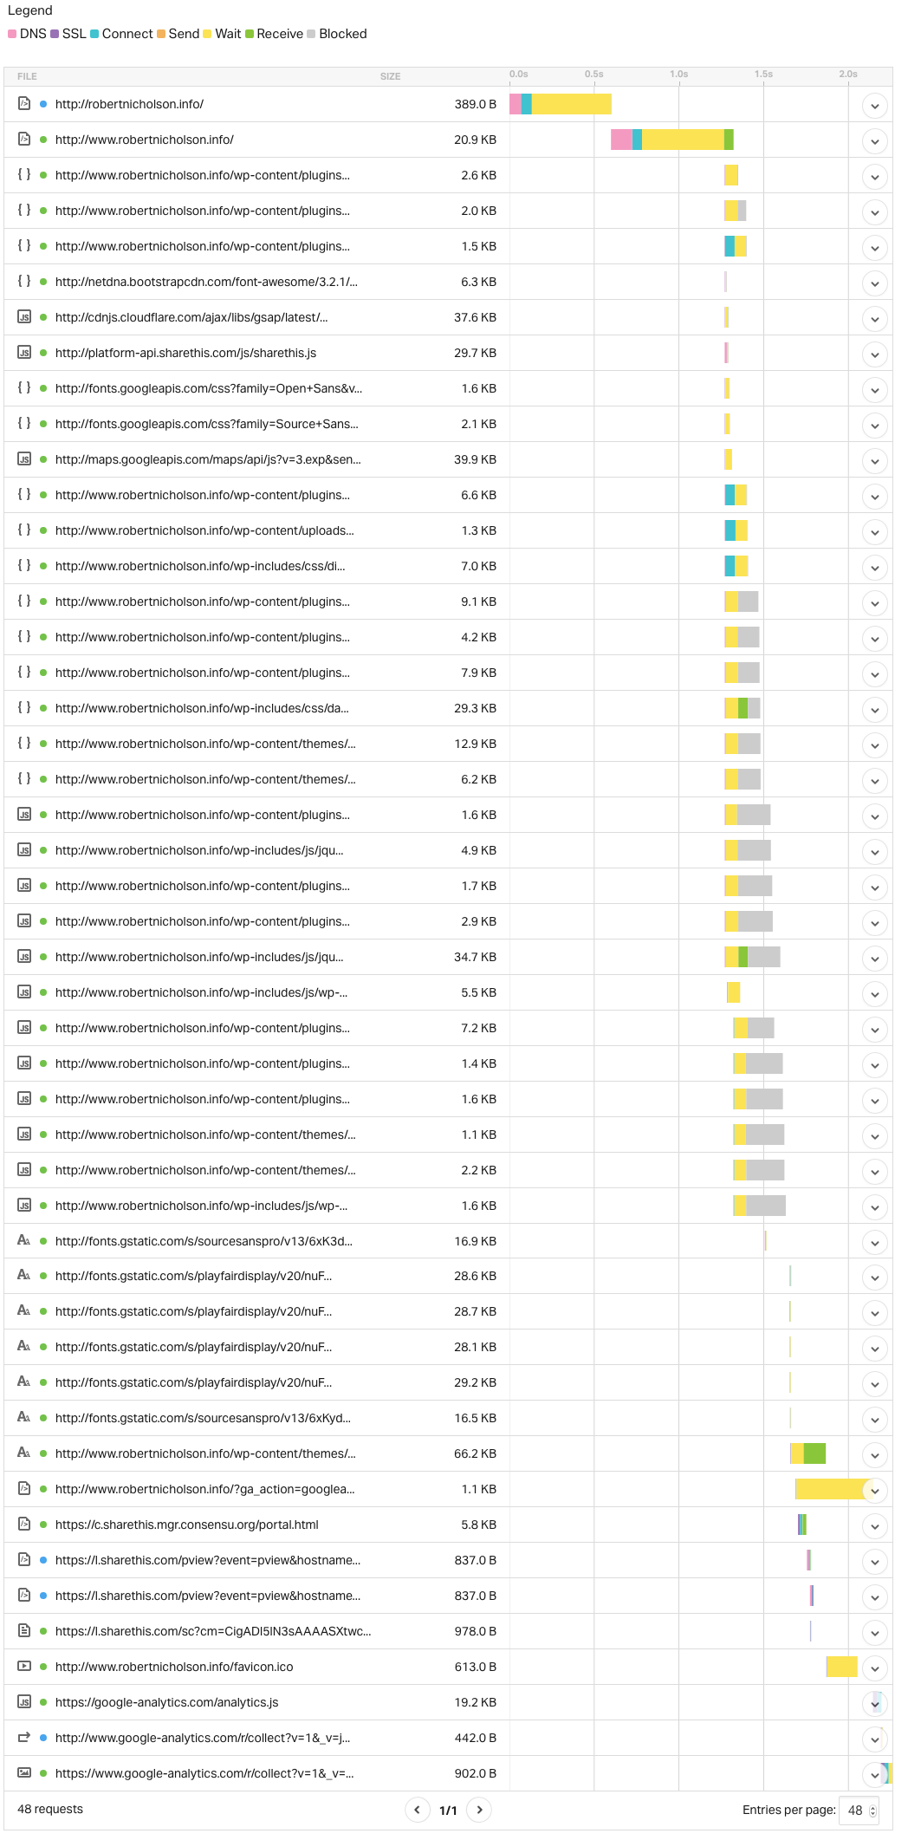
Fetching and Building a Page
The home page on my own website requires 48 separate fetches https://tools.pingdom.com/
Complex websites may require hundreds of fetches for a single page
May require fetches from several domains
Ads
Shared font files
Services such as Google Analytics
Handshakes may take a significant part of the overall load time

Slide 47
What Are Cookies?
A cookie is a named data element, stored by the browser, and associated with a website
Application code on a website can set a cookie, such as SESSION_ID
On subsequent web page requests, the web application code can request the value of cookies the website set
This is used to allow logins and sessions
Cookies can only be retrieved by the site that set them
…but there is an important loophole!

Slide 48
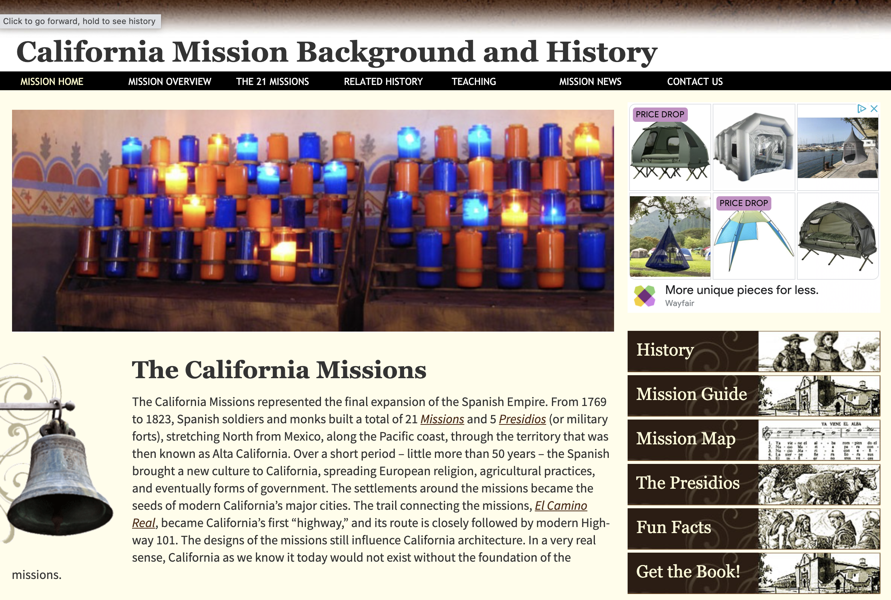
Embedded Content
Embedded Ad (Google)

Slide 49
How Cookies Are Used for Tracking
Remember that a single webpage may be built from many web requests
If a website includes ads from an ad agency, such as Google, applications on that web server can set cookies
If pages on other websites also include ads from the same agency, that web server can request the cookie value
In this way, and ad agency can track the sites that you visit, and display similar ads

Slide 50
How Cookies Are Used for Tracking
Website 1 Server
Ad Server
Website 2 Server
Browser
Web Site 1
Web Site 2
AD
AD

Slide 51
Additional Web Server Functions
Run back-end programs that dynamically build pages and send them to the browser
php
Java
Microsoft Active Server Pages (ASP)
Binary executable programs - Common Gateway Interface (CGI)
Respond to additional protocols
Cache commonly accessed pages to improve speed

Slide 52
Additional Web Protocols
HTTP get & HTTP post
Two ways for a browser to submit form data to a program on the web server, which may then access databases and return appropriate page contents
JavaScript Object Notation (JSON): allows downloading data from a web server, to be processed by Javascript programs in the browser
Simple Object Access Protocol (SOAP): a protocol for exchanging structured data between a web client (browser) and a server
Asynchronous JavaScript And XML (AJAX): a protocol for asynchronously retrieving web content to dynamically update web pages

Slide 53
Web Forms (get & post)
Designated with an HTML form tag <form action=“/process-contact-form.php” method=“get”>
Action code processes request and returns a web page
E.g. “Thank you for contacting us”
Get method
Form fields are attached to the URL: /process-contact-form.php&name=Robert&email=Robert@sjsu.edu
Post Method
Form fields are embedded in the HTTP request

Slide 54
Web Services
A piece of software that provides a function or service over the Internet, using a standard (usually XML-based) interface
Client applications make requests from the service, and get back results
A web server is a type of API, but not all APIs are web services

Slide 55
Traditional Web Services (ca. 2007)
Traditional web services are described by a service contract written in the Web Services Description Language (WSDL)
The WSDL document is an XML document that provides a machine-readable description of how the service can be called
The WSDL document and the request and response messages are transmitted over http or https
https://www.w3.org/TR/2001/NOTE-wsdl-20010315
W3 or W3C = World Wide Web Consortium

Slide 56
Traditional Web Services
Messages use the Service Oriented Architecture Protocol (SOAP)
SOAP is also an XML-based format
https://www.w3schools.com/xml/xml_soap.asp
https://www.w3.org/TR/soap/

Slide 57
RESTful Web Services
A simpler web services protocol is REST
Representational State Transfer
A software architecture style consisting of guidelines and best practices for creating scalable web services
REST is not an interface standard
https://www.w3.org/2001/sw/wiki/REST
https://www.codecademy.com/article/what-is-rest

Slide 58
The REST Architecture
REST systems are stateless, meaning that the server does not need to know anything about what state the client is in and vice versa
Client and server implementations are independent; the only connect is via messages
In the REST architecture, clients send requests to retrieve or modify resources, and servers send responses to these requests

Slide 59
REST Requests
REST requires that a client make a request to the server in order to retrieve or modify data on the server. A request generally consists of:
an HTTP verb, which defines what kind of operation to perform (GET, POST, PUT, DELETE)
a header, which allows the client to pass along information about the request
a path to a resource
an optional message body or payload containing data

Slide 60
REST Responses
A REST Response consists of a status code and an option payload
Status code | Meaning
200 (OK) | This is the standard response for successful HTTP requests.
201 (CREATED) | This is the standard response for an HTTP request that resulted in an item being successfully created.
204 (NO CONTENT) | This is the standard response for successful HTTP requests, where nothing is being returned in the response body.
400 (BAD REQUEST) | The request cannot be processed because of bad request syntax, excessive size, or another client error.
403 (FORBIDDEN) | The client does not have permission to access this resource.
404 (NOT FOUND) | The resource could not be found at this time. It is possible it was deleted, or does not exist yet.
500 (INTERNAL SERVER ERROR) | The generic answer for an unexpected failure if there is no more specific information available.

Slide 61
Browser-Based Web Service Clients
You can invoke many web services today from a web browser using AJAX
You download JavaScript code from the web service provider that makes the AJAX calls.
Therefore, you don’t worry about what protocol the web service provider uses
Popular web service providers include Google, Facebook, Amazon, etc.

Slide 62
Web APIs
APIs (Application Program Interfaces) include Javascript function calls as well as web service interfaces
Function calls may hide the details of web services
A web service is an API, but not all API are web services
Additional differences
Web Services are network based (by definition)
APIs are protocol agnostic

Slide 63
Windowing Systems
The window system (Graphic User Interface) on a desktop computer displays content from many programs
The window system is a server – sometimes called a display server
Application programs that want to display content or interact with the user are clients.
GUI management and display features are typically implemented as function calls, which use inter-process communication to make requests from the windows server
Programs on another computer can access the GUI and devices

Slide 64
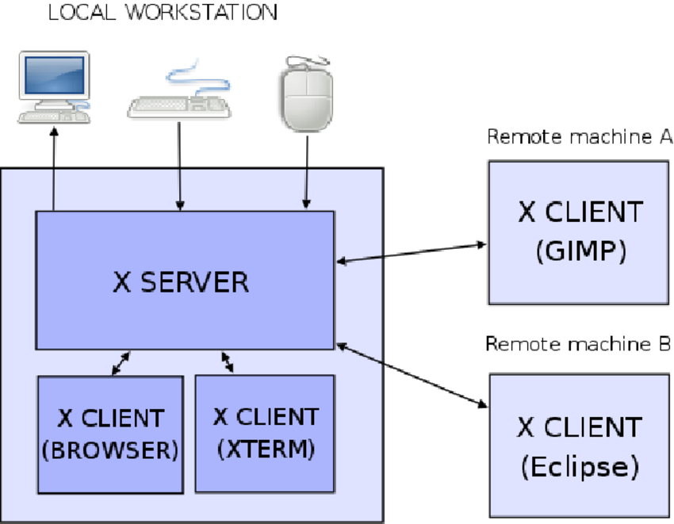
Windowing Systems

Slide 65
Windowing Systems
Microsoft Windows was originally a distinct component built on top of Microsoft DOS (Disk Operating System)
In POSIX systems, Graphic User Interfaces are based on the X-Windows server, developed at MIT in 1984
“The X Window System (X11) is an open source, cross platform, client-server computer software system that provides a GUI in a distributed network environment.”
The Macintosh windowing system was based on Darwin, a derivative of X-Windows.

Slide 66
System Software
System Software is not necessarily part of the operating system, but it includes specific knowledge of the underlying operating system and hardware, including:
Instruction set
Memory architecture and management
Process management
Network architecture
System software enables program portability, by isolating programmers and users from underlying system details

Slide 67
System Software
System software has grown in complexity
Successfully writing system software requires:
A knowledge of system specifics
A knowledge of algorithms and data structures that have been developed over decades

Slide 68
For Next Class
Log in to Canvas and complete Assignment 10

